Slide 1
DETERMINANT OF FOOD INSECURITY AMONG FARMING HOUSEHOLD
Nwachukwu Ethel Izuchukwu FE/23/31409040
Nafisa Hussaini FE/23/70056264
Umma Abubakar FE/23/16894955
Maimuna Garba FE/23/75031931
Blessing Ayuba FE/23/49640378

Slide 2
TABLE OF CONTENT
CONTENT | PAGES
1. Introduction | 3
2. Aims and objectives | 4
3. About the data | 5
4. Methodology | 7
5.Result and insight | 8
6. Observation | 11
7. Recommendation | 12
8. Conclusion | 13

Slide 3
INTRODUCTION
Introduction
This report, we are going to examine rural dwellers to ascertain their predominant occupation, treats, challenges and how to assist them, using some local governments in Jigawa state as case study.
Problems we are trying to solve • we are trying to know the exact issue causing food insecurity • to find the ways to solve food insecurity in Jigawa state
Main Goal • To create an easier way for the farmers. • Find other and relevant information needed to the dwellers before trying to assist them.

Slide 4
AIMS AND OBJECTIVES
To determine the level of skilled and unskilled rural dwellers in some selected local government
To determine the employment rate
To determine the number of persons above 18 years who are not working

Slide 5
ABOUT THE DATA SET
About the dataset: The dataset we have consists of records from different rural dwellers of some selected local government in Jigawa state, their major source of income, their challenges etc.
The dataset is so useful which help by understanding the structure of the respondents, this will give us more highlight to make an analysis base on the given information on the dataset to use machine learning algorithm for developing a model to predict and analyze the problems of these farmers

Slide 6
ABOUT THE DATA

Slide 7
METHODOLOGY
Tools used in collecting the data:
We created and used google form as a questionnaire.
My team and I went for an advocacy visits to some stakeholders of the selected local government explaining to them our aim and objectives.
It took my team and I four days to carry out the survey but we divided ourselves into groups for the survey
My team and I visited Kafin hausa, Birnin kudu, Ringim, Kiyawa and Kazaure for data collection.

Slide 8
RESULT AND INSIGHT

Slide 9
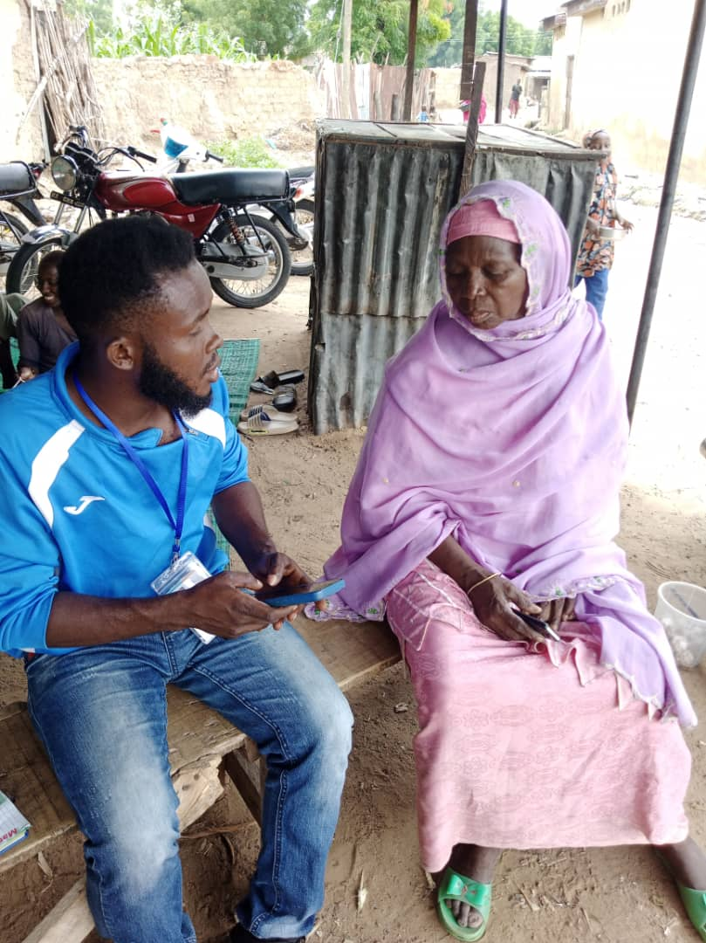
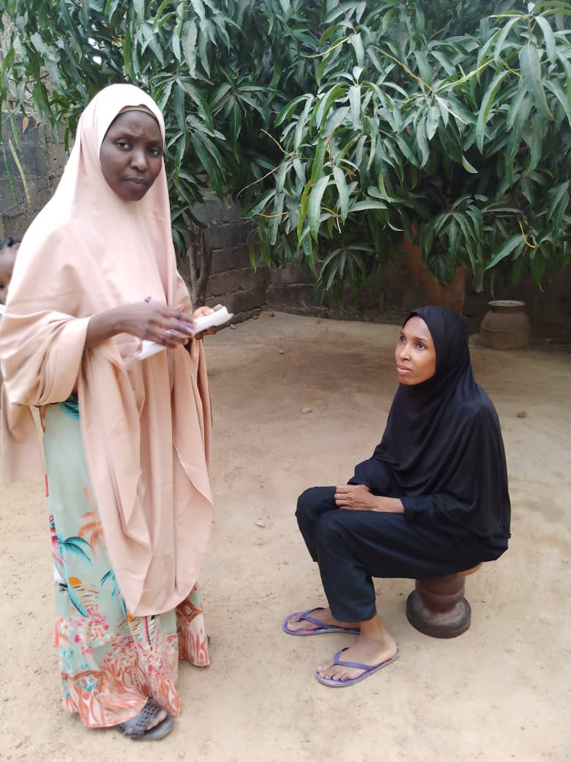
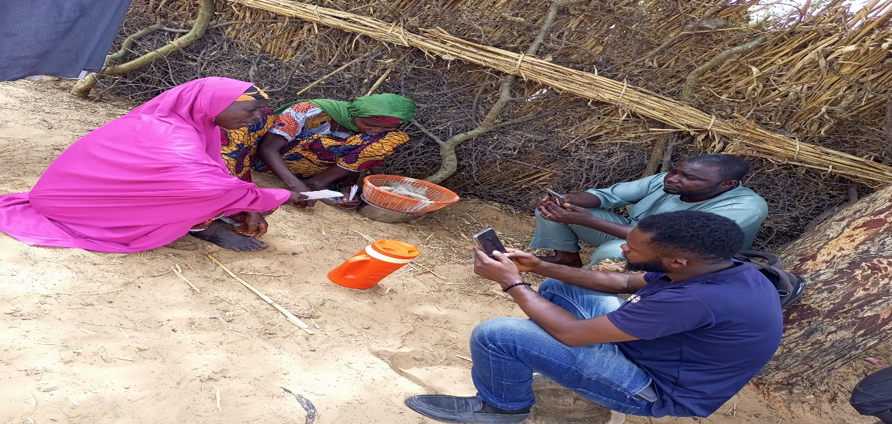
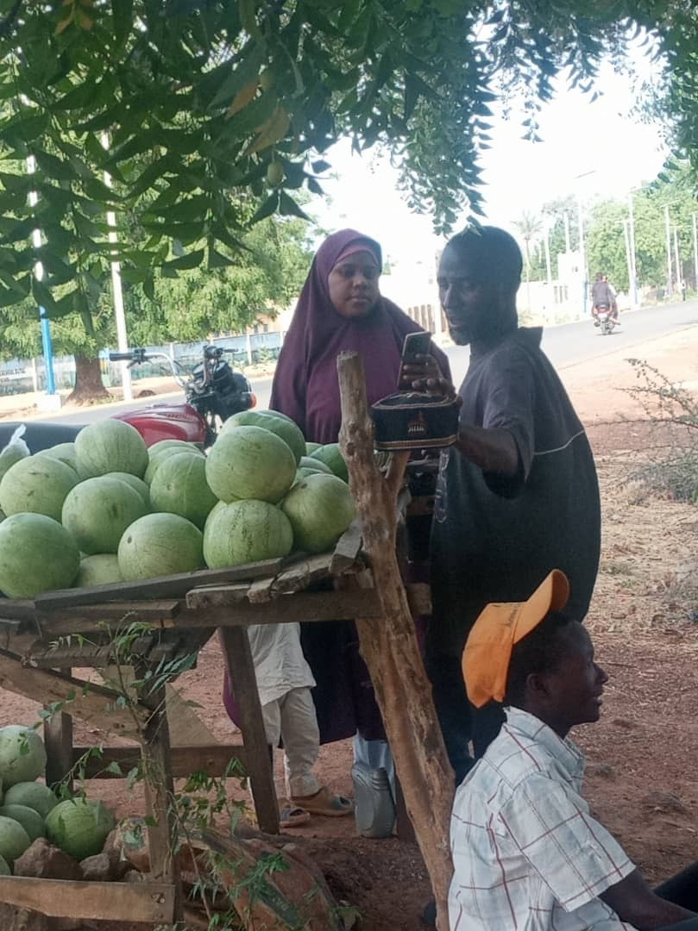
RESULT AND INSIGHT CONTINUATION

Slide 10
INTERPRETATION OF THE CHARTS ABOVE
The bar charts shows the number of children above 18 years who are not working but eligible to work
The histogram shows the number of skilled and unskilled respondents in various local governments
The line chart shows the level of employed, unemployed and self employed respondents in each local government. For the course of this data, we will assume that all unemployed respondents are not employed but they engage in menial jobs to sustain themselves
The pie chart shows the main source of income of the respondent in this data set, which are as follows:
Farming 47%
Trade 31%
Civil servant 22%

Slide 11
OBSERVATION
Majority of the farmers are illiterate which makes most of them not to adapt to new innovations relating to agriculture
Majority of the rural dwellers don’t have skills which makes farming the predominant source of income
Most farmers get low yield from their farm which is as a result of poor aid, subsidy, weather conditions etc.
Most farmers don’t make use of mechanized implement in their farm due to lack of resources
The rural dwellers don’t eat balance diet rather more of carbohydrate due to poverty
Unemployment is predominant which makes it difficult for farmers to fund their farm work

Slide 12
PROBLEM SOLVING/RECOMMENDATION
Educational Programs: Utilize data analytics to identify areas with low literacy rates among farmers and their children. Collaborate with educational institutions to develop targeted literacy and skills development programs.
Skill Development Platforms: Create online or mobile-based platforms offering vocational training and skill development courses tailored to the needs of farmers and their children. Analyze data to identify the most in-demand skills in the region.
Agricultural Technology Adoption: Use data analytics to identify modern agricultural practices suitable for the region's climate and soil conditions. Introduce technologies such as precision farming, crop monitoring systems, and efficient irrigation techniques to improve productivity and reduce reliance on manual labor.
Access to Market Information: Develop digital platforms or mobile applications providing real-time market information, including crop prices, market demand, and supply chain logistics. This empowers farmers to make informed decisions and negotiate better prices for their produce.

Slide 13
Microfinance and Access to Credit: Analyze financial data to identify viable microfinance opportunities for farmers to invest in modernizing their farming practices or starting small businesses. Facilitate access to credit and financial services to empower farmers economically.
Community Engagement and Awareness Programs: Utilize data analytics to understand community dynamics and preferences. Design targeted awareness campaigns on the importance of education, skill development, and technological advancement in agriculture to encourage participation and adoption.
Collaborative Platforms: Establish partnerships with government agencies, NGOs, and private sector organizations to leverage resources and expertise in addressing the multifaceted challenges faced by farmers and their families.
By leveraging scientific and technological methods through data analytics, you can contribute to uplifting the socioeconomic conditions of farmers in Jigawa and improving the prospects of their children.

Slide 14
CONCLUSION
Government should create a database containing all the local farmers in Jigawa state.
We will recommend conducting an intensive survey on rural farmers using ODK collect, RR collect or Kobo collect tools to get these farmers onboard database
Government should grant aids to farmers to expand their farm
Government should create an avenue for rural dwellers to acquire profitable skills

